Slide 1

Confidence Talk
自信说

Slide 2
We are the civilian version of the King of the Speech.
我们是平民版的「国王的演讲」。

Slide 3
PROBLEM
Confidence decides outcomes of the speech, sales and relationship.
自信影响演讲、销售甚至搭讪的效果。
A successful presentation = 38% voice + 55% gesture + 7% content
成功的演讲 = 38% 声音质量 + 55% 肢体语言 + 7% 内容
Unconfident people miss out many opportunities due to their bad performance in presentation.
缺乏自信的人往往在公众演讲中表现不佳，从而错失许多机会。

Slide 4
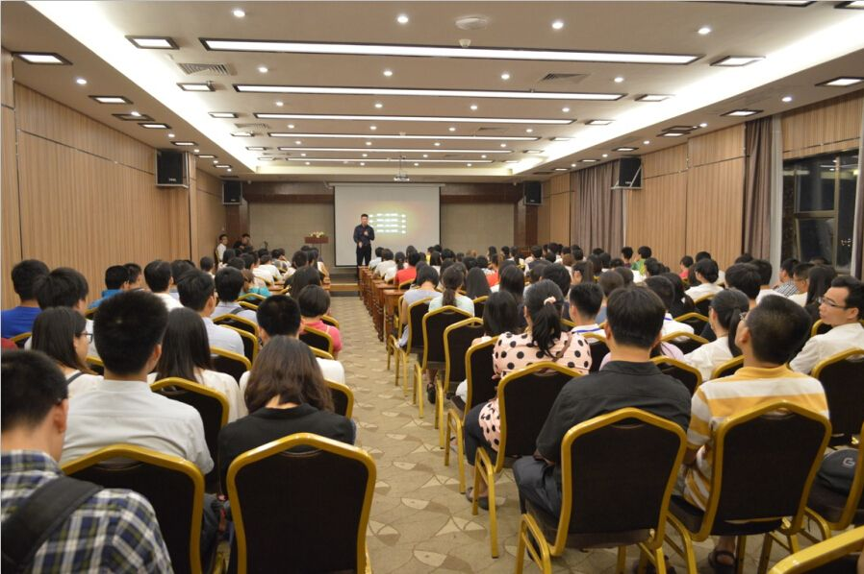
CURRENT SOLUTION
Training is difficult, costly and poor feedback.
传统训练方式往往极不方便，价格昂贵并且缺少反馈。
500rmb/hr
以上

Slide 5
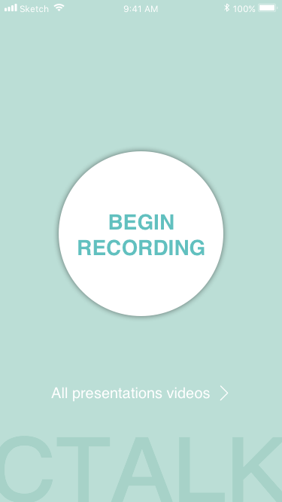
OUR SOLUTION
A “Smart Confident Speech Coach” which provides real-time and post-hoc analysis of confidence and quality of his speech, guiding the user into a more impactful and persuasive communicator.
一款“智能自信沟通口袋教练”帮助用户提升公众演讲能力和自信心。

Slide 6
How our service works
0) User downloads 用户下载
1) User practices speech and communication with Ctalk
用户利用Ctalk练习演讲和沟通场景
2) Ctalk sees the user body language in real time and post hoc basis and provides expert advice Ctalk现场分析用户肢体和语言给出适当的建议
3) User learns from Ctalk and makes easy to transition to speaking 用户通过Ctalk变成自信沟通者

Slide 7
How our service works
本项目利用手机自带的前置摄像头获得用户练习公众演讲的音视频数据，从中提取整合信息以评估用户每次演讲的效果。我们搭建的APP提供对用户演讲的点评与打分，并提供标注出扣分点的音视频回放，以满足用户对自身公众演讲练习-评估-改良的需求。

Slide 8
TARGET CUSTOMER
In occupations where confident communication makes a impact
Smart Phone/Smart Home users
Lifelong learners

Slide 9
BUSINESS MODEL
Schools and teachers(B2B2C) :to help students learn faster
Individuals(B2C): for personal improvement
Businesses(B2B): Corporate training

Slide 10




OUR TEAM
张凌威（CTO）
林裕腾（CEO）
王佳璇（CDO）
蔡顺杰（CMO）
大数据智能
移动开发
用户体验
项目管理

